Slide 1

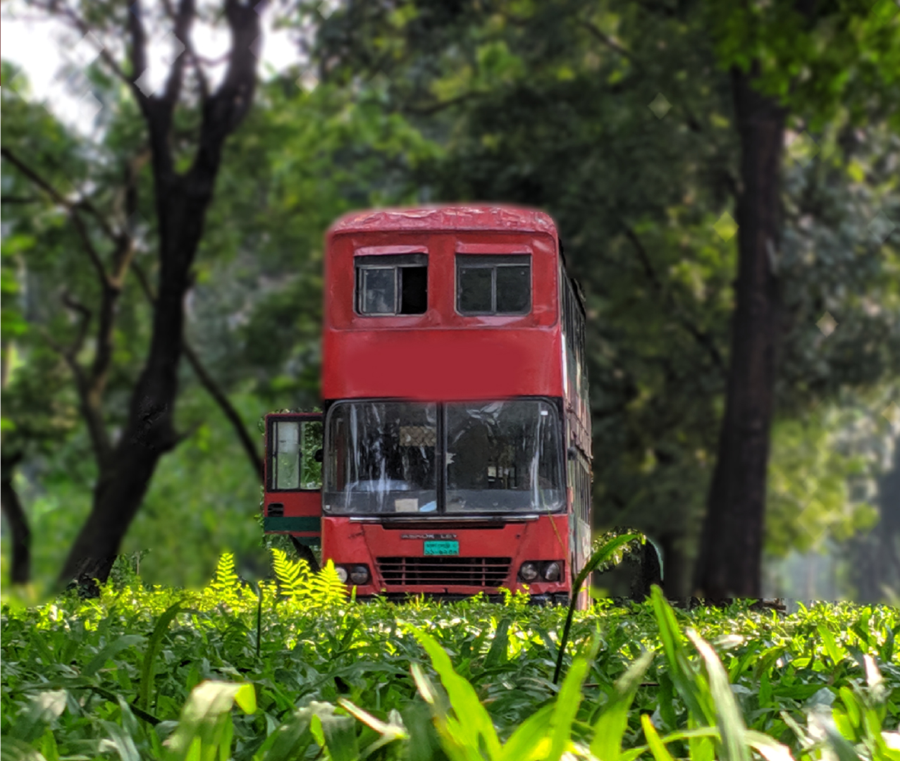
DHAKA CITY LOCAL BUS ROUTE
SUBMITTED BY
Jahirul Alam Fahim (CS-2001054)
Mahzabin Jahan Anika (CS-2001053)
Somaiya Akter (CS-2001052)
MD. Tarikul Islam Tamim (CS-2001056)

Slide 2
Concept
It was close to home dissatisfaction from the normal public who were rookies to Dhaka city. Their case was such countless neighborhood transports however didn't have a clue where the transport really go and it was my own concern as well. Then, at that point, the possibility of the neighborhood transport course and assembling them across the board place in a C program and made the issue simpler to address the faltering with regards to the course of nearby transports.

Slide 3
FLOW-CHART
Enter the alphabet
if 0
0 or 1
Check if entry
No bus found
no
yes
List of bus
if 0
0 or other input
other number
if 0
show that bus route
if 1
O or 1
if 1
Thank you

Slide 4
FEATURE
When the user will press a letter, the bus list related to that letter would show up.
After showing the bus list, if the user presses the designated bus number. All the route related to that bus would show up on the next list.
At the end of the program there’s a system to go back to the beginning .Also the user can search bus information without terminating the program.

Slide 5
Benefits
User can access through these information in an instant to save their valuable time
Those who don’t know about the route of that specific bus can know the information very quickly
Its very useful to those who are newcomer in Dhaka city
By providing these kind of information, public who are travelling can ensure their destination and have a peaceful journey.

Slide 6
LIMITATION
In this continuous undertaking, for the present, the client can just information the letter set and find that letters in order related transport. Later on, we will take destination info moreover. So clients can get that objective related transport and acquire data through the cycle.
However this task is just for educational purposes constant information and spots might change and may set aside a little effort to refresh the right data.
For now we only updated up to 4 buses in each alphabet to demonstrate our project. All the buses and routes will be updated in the future accordingly.

Slide 7
CONTRIBUTION

Slide 8
Thank You

